Slide 1




AIEYS
Introduction to HTML
Example:
Portfolio Website
PRESENTATION

Slide 2
AIEYS
Title and content Layout list
HADER SETUP
HOMEPAGE
BIO SKETCH
CONTACT ME
EDUCAYINAL DETAIL
BS(HONS.) THESIS
ACHIVEMENTS
PRESENTATION

Slide 3
YOUR LOGO
Source Code of Header in HTML
and Style
Graduate Thesis Defense PPT Template
PRESENTATION

Slide 4
SOURCE CODE OF STYLE
<style>
body {
font-family:Geneva, Arial, Helvetica, sans-serif;
}
.navbar {
overflow: hidden;
}
.navbar a {
float: left;
font-size: 19px;
color:#666666;
text-align: center;
padding: 14px 18px;
text-decoration: none;
font-family:Geneva, Arial, Helvetica, sans-serif;
font-weight:300;
}
.dropdown {
float: left;
overflow: hidden;
}
.dropdown .dropbtn {
font-size: 19px;
border: none;
outline: none;
color:#666666;
padding: 14px 16px;
background-color: inherit;
font-family: inherit;
margin: 0;
}
h1{font-size:36px;
color:#330000;
}
img{
padding-top:60px
}
p{
padding-left:60px;
padding-right:60px;
text-align:justify;
font-family:Geneva, Arial, Helvetica, sans-serif;
font-size: 19px;
font-style:normal;
color: #666666;
}
h1{
padding-top:60px;
padding-bottom:60px;
text-align:center;
text-decoration:underline 5px;
}
h3{
padding-top:40px;
padding-left:60px;
font-size:30px;
color:#330000;
}
img{padding-left:60px;
}
.container {
display: flex;
align-items: left;
justify-content: left;
}
.navbar a:hover, .dropdown:hover .dropbtn {
background-color:#FFFFFF;
}
.dropdown-content {
font-family:Geneva, Arial, Helvetica, sans-serif;
display: none;
position: absolute;
background-color:#CCCCCC;
min-width: 160px;
box-shadow: 0px 8px 16px 0px rgba(0,0,0,0.2);
z-index: 1;
}
.dropdown-content a {
font-family:Geneva, Arial, Helvetica, sans-serif;
float: none;
color: black;
padding: 12px 16px;
text-decoration: none;
display: block;
text-align: left;
}
.dropdown-content a:hover {
background-color:#CCCCCC;
}

Slide 5
AIEYS
<body style="background-color:white;">
<div class="navbar">
<a href="home page.html"> <b>BS(Hons.) Muhammad Shoaib Qamar</b></a>
<div class="dropdown">
<button class="dropbtn">Home
<i class="fa fa-caret-down"></i>
</button>
<div class="dropdown-content">
<a href="portfoli.html">biosketch</a>
<a href="contact.html">Contact</a>
<a href="CV.html">CV</a>
<a href="Educational.html">Eduction Details</a>
</div>
</div>
<a href="thesis.html"> Abstract of my BS(Hons.) Thesis </a>
<a href="achivements.html"> Achivements </a>
<a> Awards and Honors </a>
<div class="dropdown">
<button class="dropbtn">More
<i class="fa fa-caret-down"></i>
</button>
<div class="dropdown-content">
<a href="#"></a>
<a href="#"></a>
<a href="#"></a>
<a href="#"></a>
</div>
</div>
</div>

Slide 6
YOUR LOGO

Slide 7
AIEYS
Source code of drop down box
Presentations are communication tools

Slide 8
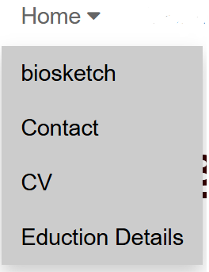
AIEYS
<div class="dropdown">
<button class="dropbtn">Home
<i class="fa fa-caret-down"></i>
</button>
<div class="dropdown-content">
<a href="portfoli.html">biosketch</a>
<a href="contact.html">Contact</a>
<a href="CV.html">CV</a>
<a href="Educational.html">Eduction Details</a>
</div>

Slide 9
AIEYS
Source Code of Welcome Page

Slide 10
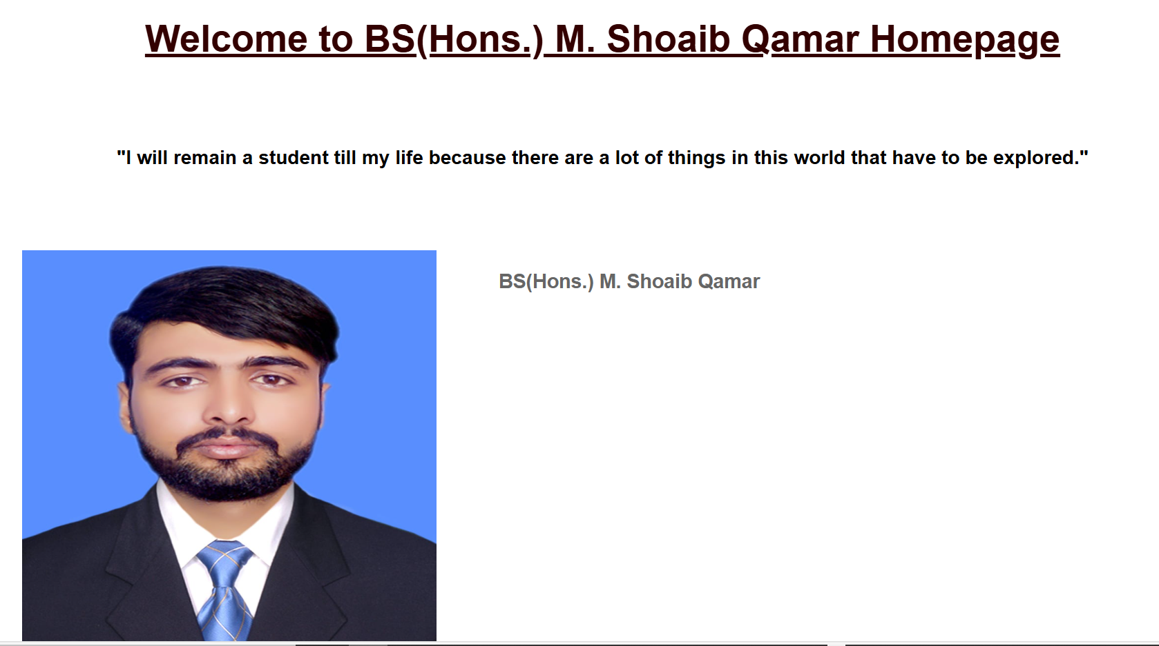
AIEYS
<h1>Welcome to BS(Hons.) M. Shoaib Qamar Homepage</h1>
<div>
<h3> "I will remain a student till my life because there are a lot of things in this world that have to be explored." </h3>
</div>
<div class="container">
<div class="image">
<img src="1.jpg" alt width="400" height="400" />
</div>
<div class="text">
<p>
<b>BS(Hons.) M. Shoaib Qamar </b>
</p>
</div>
</div>

Slide 11
AIEYS
Source Code of Bio Sketch

Slide 12
AIEYS
<h1>Bio Sketch</h1>
<div>
<p> Short Biography of BS(Hons.) M. Shoaib Qamar </p>
</div>
<div class="container">
<div class="image">
<img src="1.jpg" alt width="400" height="400" />
</div>
<div class="text">
<p>As a BS Computer Science student, focusing on the core subjects is crucial. These include programming fundamentals with languages like Python, Java, or C++, as well as mastering data structures and algorithms for problem-solving and technical interviews. It's also essential to understand databases, both relational (e.g., MySQL) and NoSQL (e.g., MongoDB), along with operating systems, computer networks, and software engineering principles. Exploring advanced topics such as machine learning, AI, web development, mobile app development, and cybersecurity can open up diverse career opportunities. Alongside academics, consistently practicing coding on platforms like LeetCode or HackerRank, collaborating on group projects using tools like Git, and participating in hackathons can greatly enhance your skills. Building a strong project portfolio, gaining practical experience through internships, and staying updated on tech trends will set you apart. Developing communication skills to effectively explain technical concepts is equally important for success in this field.
</p>
</div>
</div>

Slide 13
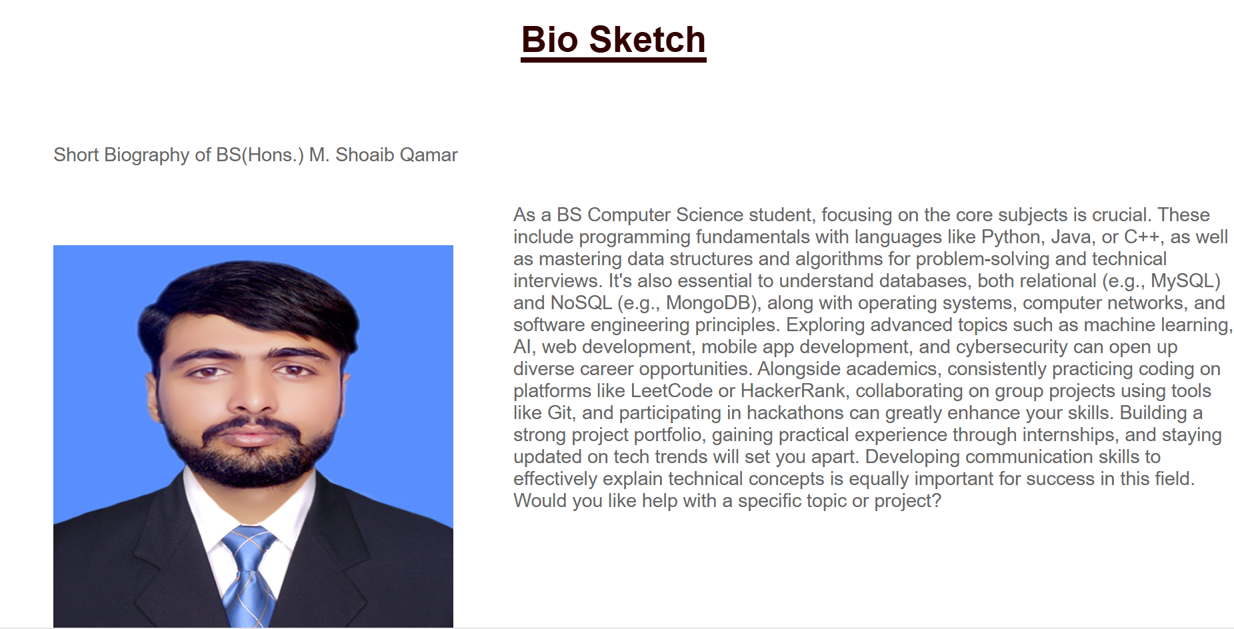
AIEYS

Slide 14
AIEYS
Source Code of Contact

Slide 15
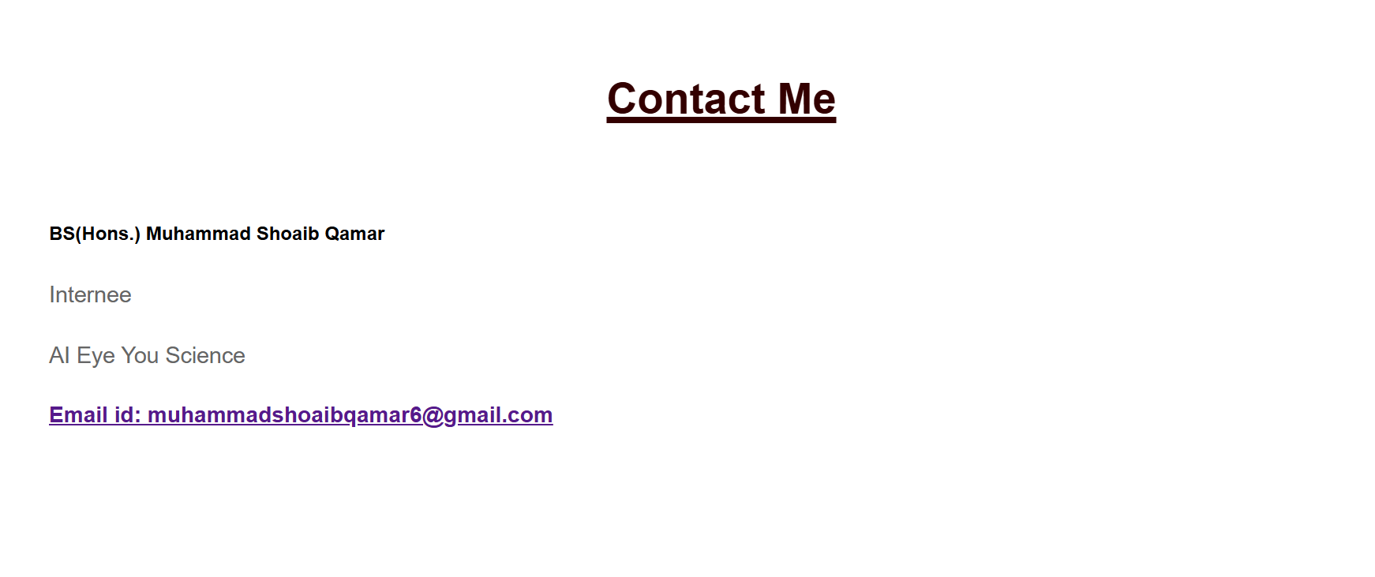
AIEYS
<h1>Contact Me</h1>
<div>
<h4> BS(Hons.) Muhammad Shoaib Qamar</h4>
<p> Internee </p>
<p> AI Eye You Science</p>
<h3> <a href="">Email id: muhammadshoaibqamar6@gmail.com</a></h3>
</body>

Slide 16
AIEYS
Source Code of Educational detail

Slide 17
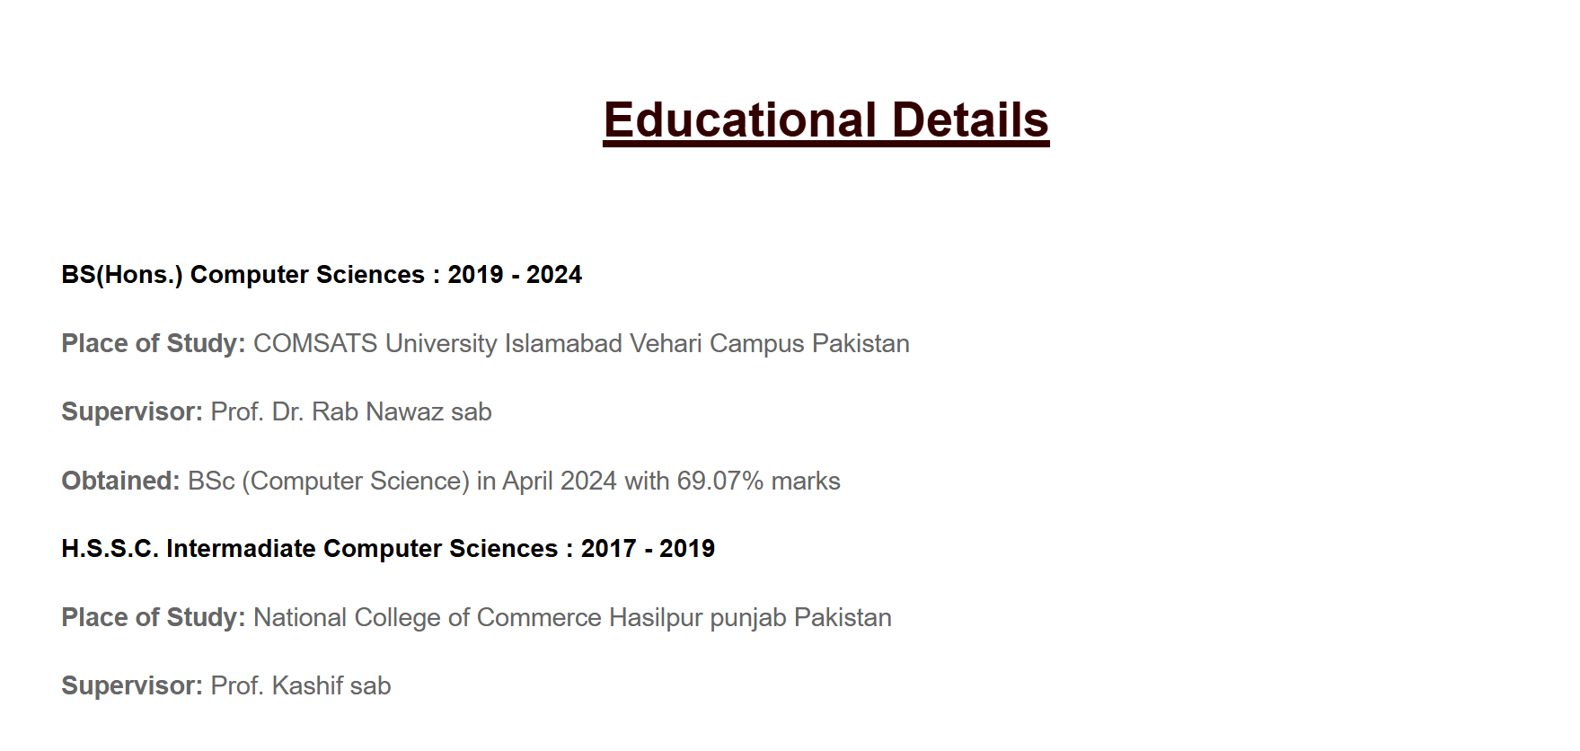
AIEYS
<h1>Educational Details</h1>
<h3> BS(Hons.) Computer Sciences : 2019 - 2024</h3>
<p><b> Place of Study:</b> COMSATS University Islamabad Vehari Campus Pakistan</p>
<p><b>Supervisor: </b> Prof. Dr. Rab Nawaz sab</p>
<p><b> Obtained:</b> BSc (Computer Science) in April 2024 with 69.07% marks</p>
<h3> H.S.S.C. Intermadiate Computer Sciences : 2017 - 2019</h3>
<p><b> Place of Study:</b> National College of Commerce Hasilpur punjab Pakistan</p>
<p><b>Supervisor: </b> Prof. Kashif sab</p>

Slide 18
AIEYS
Abstract of my BS(Hons.) Thesis

Slide 19
AIEYS
<h1>Abstract of my PhD Thesis</h1>
<h1> Abstract:</h1>
<div>
<p>Every business marketing manager / CEOs need to have the most current customer information at their fingertips and be able to work on the move. While on the road they need the ability to create and update all of their records, see what is planned, how they are progressing, have answers ready for their customers, and more importantly, be prepared for upsell opportunities.
CRM will help us to manage your end-to-end sales cycle with access to Leads, Contacts, Accounts, Potentials, Tasks, Events, Calls, Inventory, and Custom modules in CRM.</p>
<h1>INTERODUCTION</h1>
<h3>1.1: System Introduction</h3>
<p>
Every business marketing manager / CEO s need to have the most current customer information at their fingertips and be able to work on the move. While on the road they need the ability to create and update all of their records, see what is planned, how they are progressing, have answers ready for their customers, and more importantly, be prepared for upsell opportunities.
CRM will help us to manage your end-to-end sales cycle with access to Leads, Contacts, Accounts, Potentials, Tasks, Events, Calls, Inventory, and Custom modules in CRM.</p>
</div>
<h3>1.2: Background of the System</h3>
<p>
We have studied applications that have been working in the domain at that time, but these applications cannot fulfill the requirements of application CUSTOMER RELATION MANAGEMENT. The applications that are working in the domain are more cost. These applications have also a drawback of less communication of CRM. Those applications also not provide the main environment of Customer Relationship Management. It is also envisaged that the CRM be able to integrate with other systems, both current and future, to maximize data sharing and reporting. The CRM will be a crucial tool in being able to efficiently manage client contact, communication and reporting.
</p>
<h3>1.3: Significance of the System</h3>
<p>
The importance of our system is that it is faster and reliable then manual system. It helps the user and company to save their time and make them boundless. Boundless means they can use the application whenever they want without the restriction of time. Application plays an important role among user and company. It can also play an important role in faculty to make supervision process online.
The significance of this study it is expected to provide an insight into the research process in this new area of technological development in Sudan. Even though a lot of studies have been conducted in this area, but their limitation is obvious: they did not investigate the relationship between CRM dimensions, organizational performance and customer satisfaction. This paper is unique in analyzing the relationship and fills the gap in the literature by focusing on the study of the factors of CRM dimensions that influence the organizational performance in telecommunication companies in Sudan, and how are these companies can benefit from this study to face critical organizational issues of adaptation, survival, and competence in the face of an increasingly changing environment.
</p>
<<p>

Slide 20
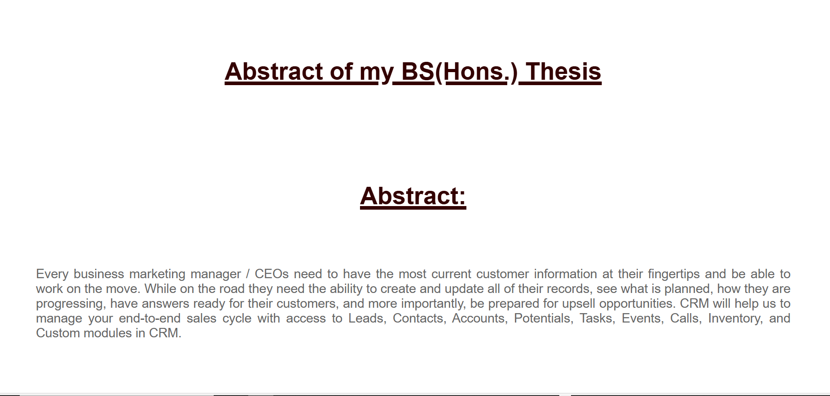
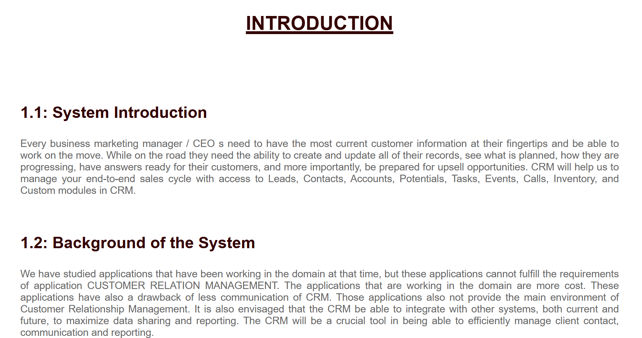
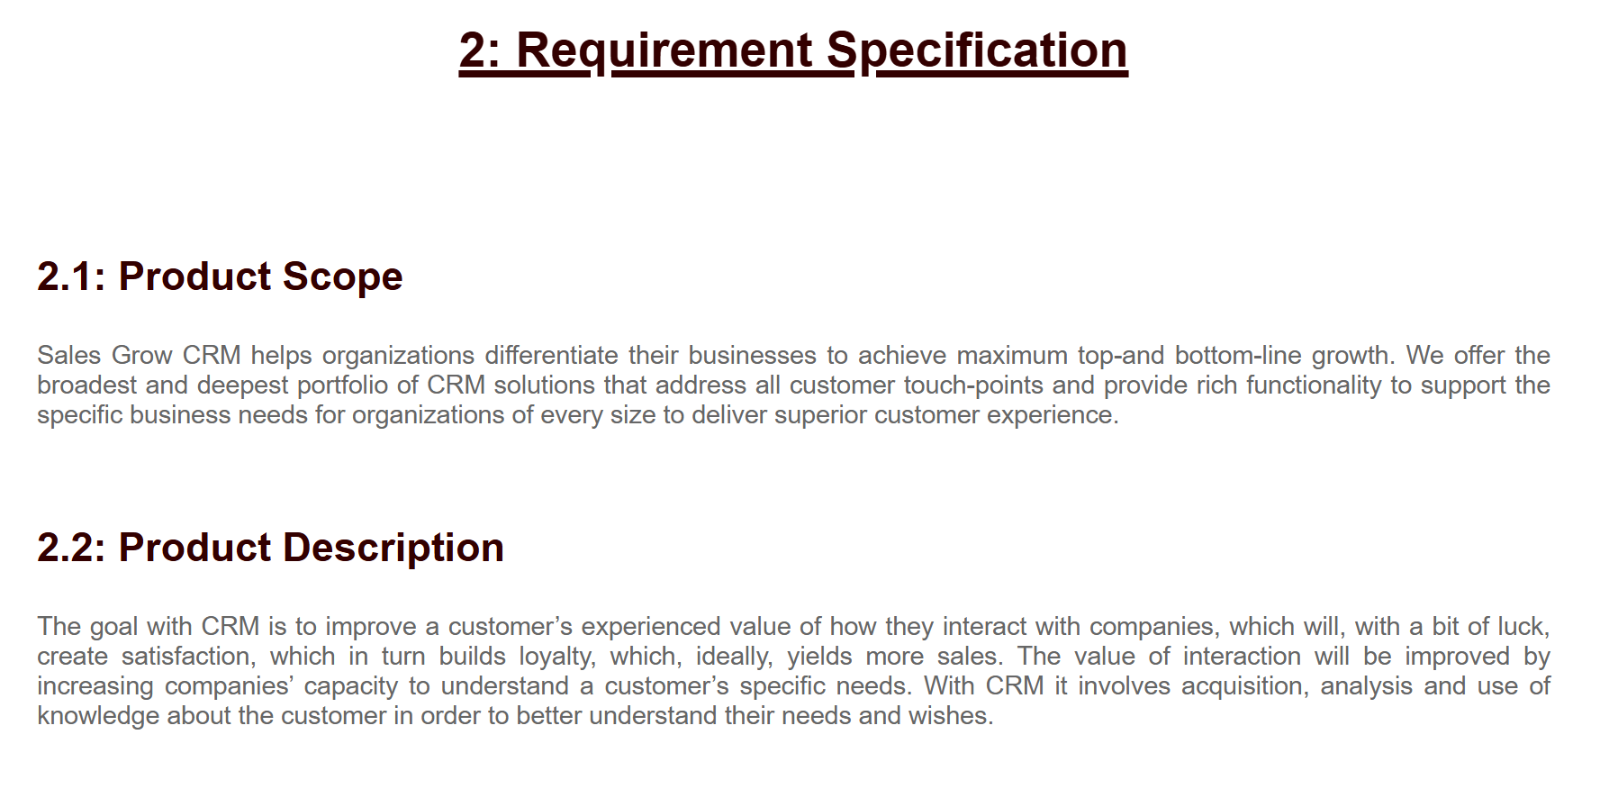
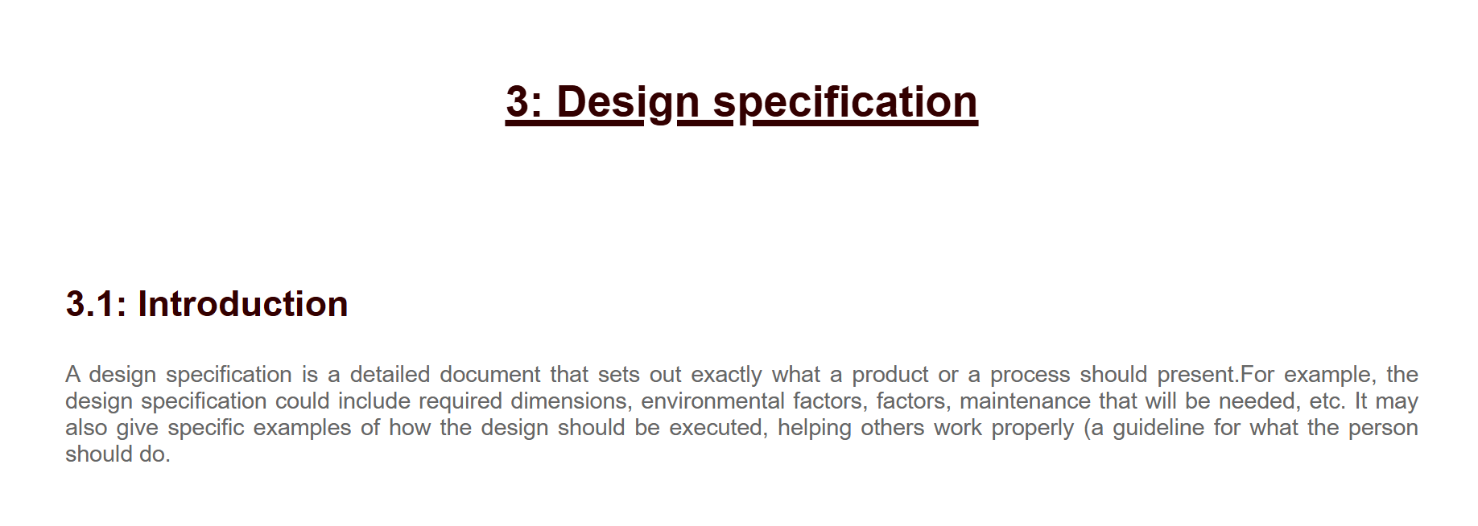
AIEYS

Slide 21
AIEYS
Source Code of Achivements

Slide 22
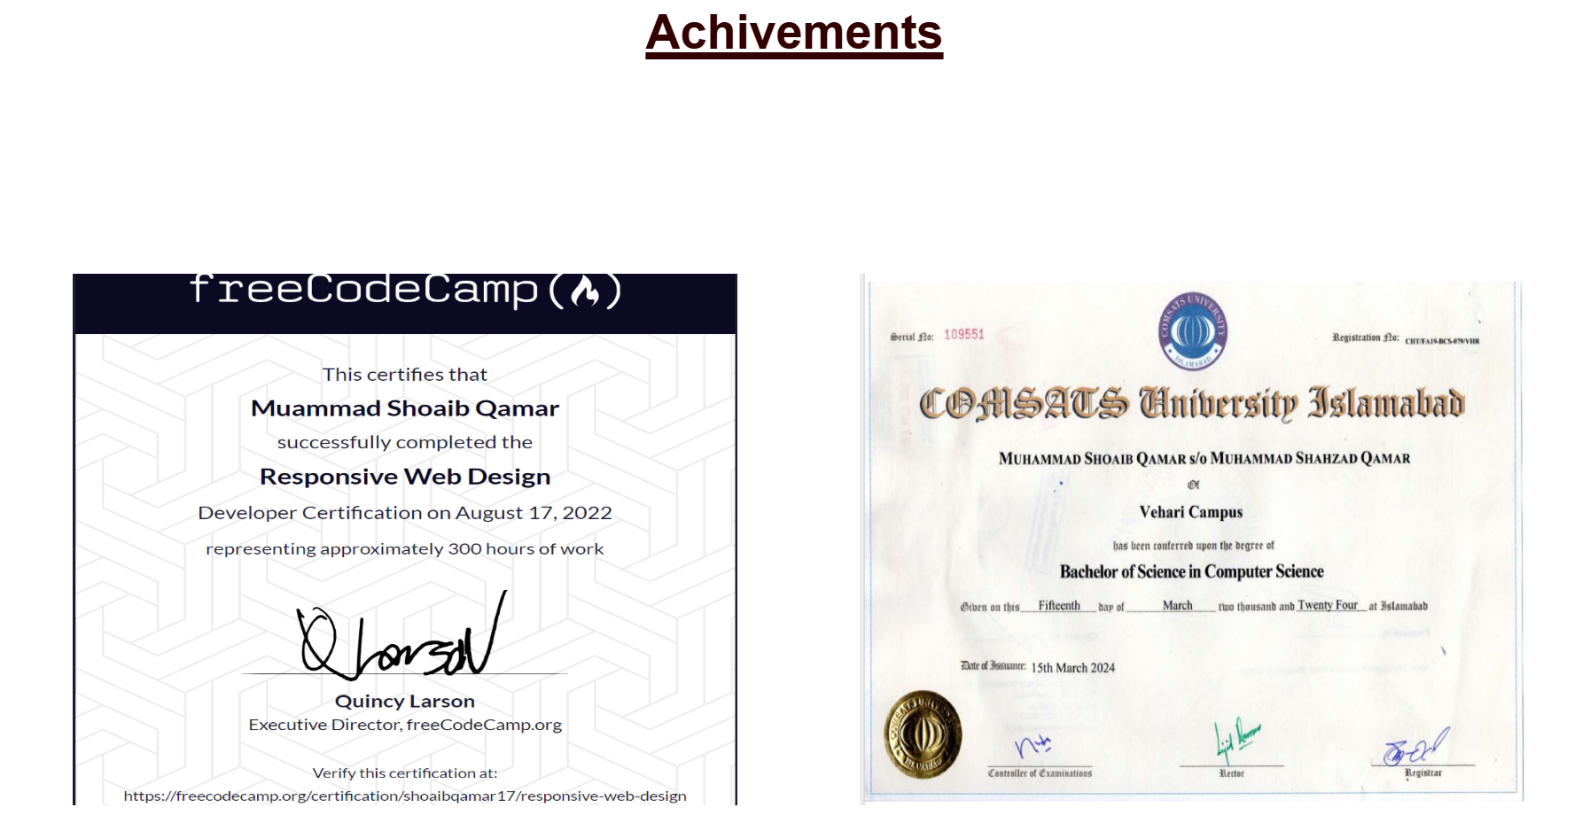
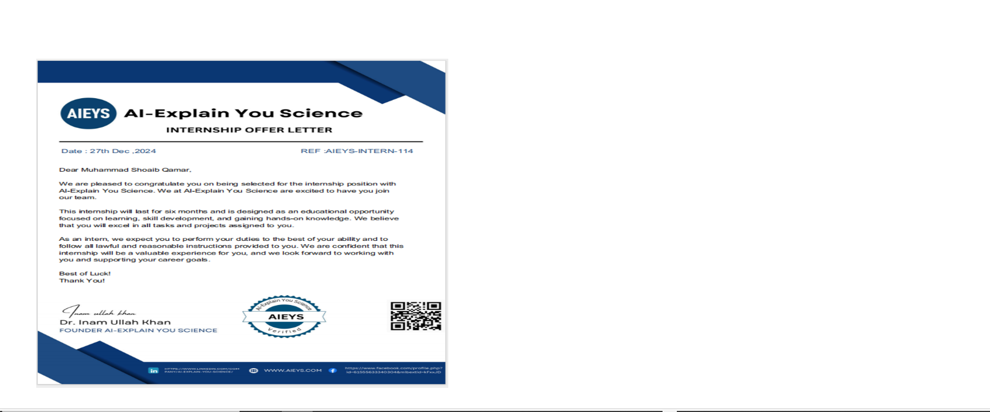
AIEYS
<h1> Achivements</h1>
<table>
<tr>
<th><img src="code.png"alt width="500" height="400"></th>
<th><img src="bsdegree.png" alt width="500" height="400"></th>
</tr>
<tr>
<th><img src="web.png"alt width="500" height="400"></th>
</tr>
</table>

Slide 23
AIEYS
Thank you
For watching
PRESENTATION

